Slide 1

ILP 2022 – W2S2 If/Elif/Else statements
Matthieu DE MARI – Singapore University of Technology and Design

Slide 2
Outline (Week2, Session2 – W2S2)
The if statement
The elif statement
The else statement
Dead code and code structure
Nested ifs

Slide 3
The if statement
The if statement is the simplest conditional structure.

Slide 4
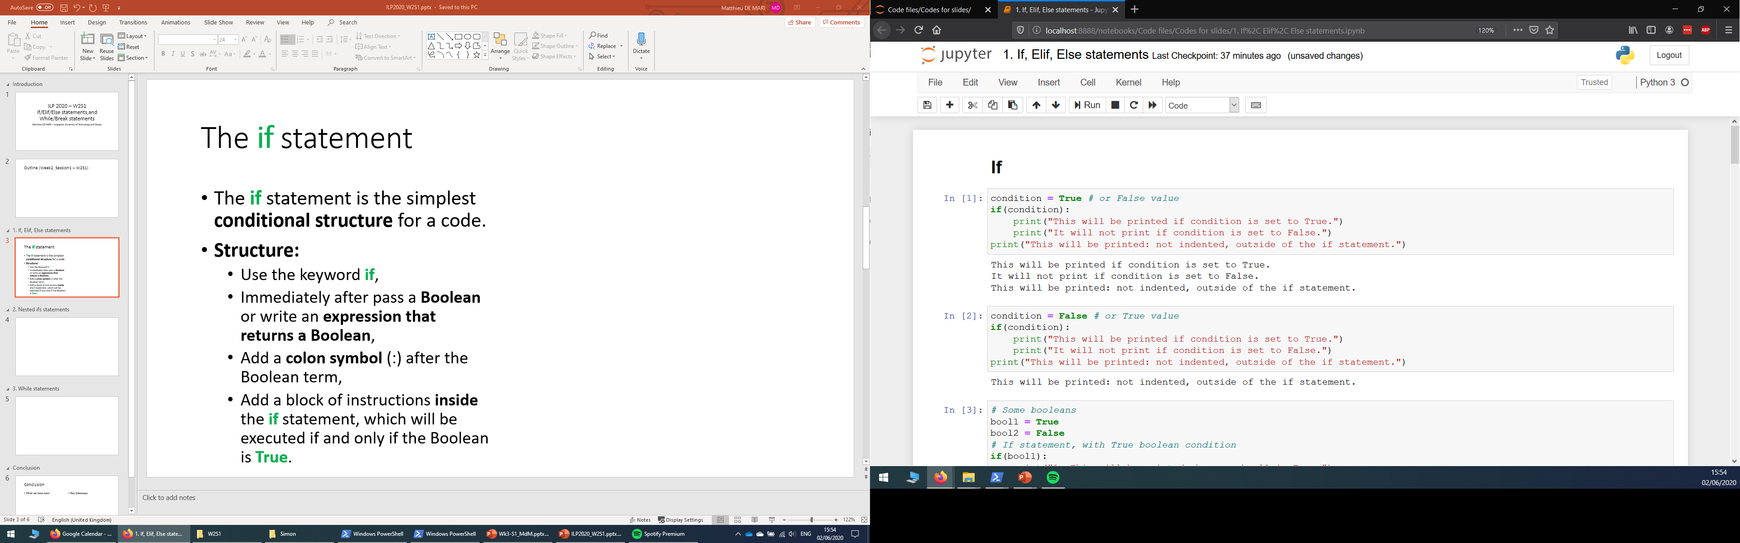
The if statement
The if statement is the simplest conditional structure.
Structure:
Use the keyword if,

Slide 5
The if statement
The if statement is the simplest conditional structure.
Structure:
Use the keyword if,
Immediately after, pass a Boolean variable or write an expression that returns a Boolean,

Slide 6
The if statement
The if statement is the simplest conditional structure.
Structure:
Use the keyword if,
Immediately after, pass a Boolean variable or write an expression that returns a Boolean,
Add a colon symbol (:) after the Boolean term,

Slide 7
The if statement
The if statement is the simplest conditional structure.
Structure:
Use the keyword if,
Immediately after, pass a Boolean variable or write an expression that returns a Boolean,
Add a colon symbol (:) after the Boolean term,
Add a block of instructions inside the if statement, which will be executed if and only if the Boolean is True.

Slide 8
The if statement
The if statement is the simplest conditional structure.
Structure:
Use the keyword if,
Immediately after, pass a Boolean variable or write an expression that returns a Boolean,
Add a colon symbol (:) after the Boolean term,
Add a block of instructions inside the if statement, which will be executed if and only if the Boolean is True.
Note: “inside” means your instruction is indented with 4 spaces more than the if statement. Jupyter will suggest indentations.

Slide 9
The if statement
The if statement is the simplest conditional structure.
How it works:
If the Boolean condition/variable specified for the if statement is True, then execute the block of code inside the if statement.

Slide 10
The if statement
The if statement is the simplest conditional structure.
How it works:
If the Boolean condition/variable specified for the if statement is True, then execute the block of code inside the if statement.

Slide 11
The if statement
The if statement is the simplest conditional structure.
How it works:
If the Boolean condition/variable specified for the if statement is True, then execute the block of code inside the if statement.

Slide 12
The if statement
The if statement is the simplest conditional structure.
How it works:
If the Boolean condition/variable specified for the if statement is True, then execute the block of code inside the if statement.

Slide 13
The if statement
The if statement is the simplest conditional structure.
How it works:
If the Boolean condition/variable specified for the if statement is True, then execute the block of code inside the if statement.

Slide 14
The if statement
The if statement is the simplest conditional structure.
How it works:
If the Boolean condition/variable specified for the if statement is True, then execute the block of code inside the if statement.

Slide 15
The if statement
The if statement is the simplest conditional structure.
How it works:
If the Boolean condition/variable specified for the if statement is True, then execute the block of code inside the if statement.

Slide 16
The if statement
The if statement is the simplest conditional structure.
How it works:
If the Boolean condition/variable specified for the if statement is True, then execute the block of code inside the if statement.

Slide 17
The if statement
The if statement is the simplest conditional structure.
How it works:
If the Boolean condition/variable specified for the if statement is True, then execute the block of code inside the if statement.
If the Boolean condition is False, ignore the block of code in the if statement.

Slide 18
The if statement
The if statement is the simplest conditional structure.
How it works:
If the Boolean condition/variable specified for the if statement is True, then execute the block of code inside the if statement.
If the Boolean condition is False, ignore the block of code in the if statement.
Once we are done executing the code in if (or ignoring it), move on to the next (non-indented) line.

Slide 19
The elif statement
The elif statement (short for “else-if”) is used to define another conditional test to be executed, if and only if the previous if statement has failed.

Slide 20
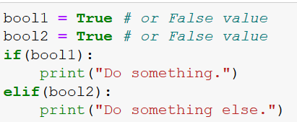
The elif statement
The elif statement (short for “else-if”) is used to define another conditional test to be executed, if and only if the previous if statement has failed.
Structure:
Write your if block as before
On the same indentation level as your if statement, write you elif statement (elif + Boolean condition + colon symbol)
Add your instructions inside the elif, by indenting your code as in if.

Slide 21
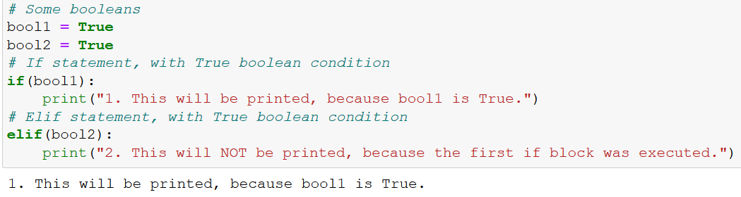
The elif statement
How it works:
If the Boolean in the if statement is True, execute the code inside the if, ignore the elif.

Slide 22
The elif statement
How it works:
If the Boolean in the if statement is True, execute the code inside the if, ignore the elif.
Did not execute even though bool2 was True.

Slide 23
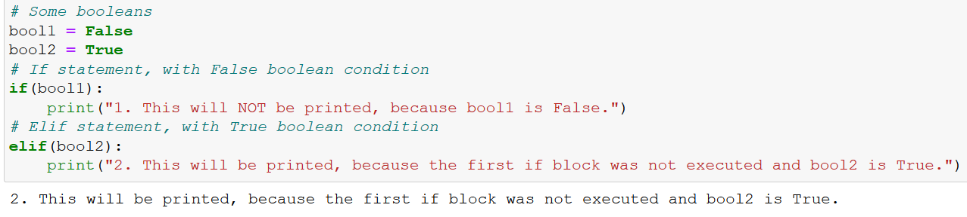
The elif statement
How it works:
If the Boolean in the if statement is True, execute the code inside the if, ignore the elif.
Otherwise, check for the Boolean in elif, and execute the code indented inside the elif, if this second Boolean condition is True. Otherwise, ignore it.

Slide 24
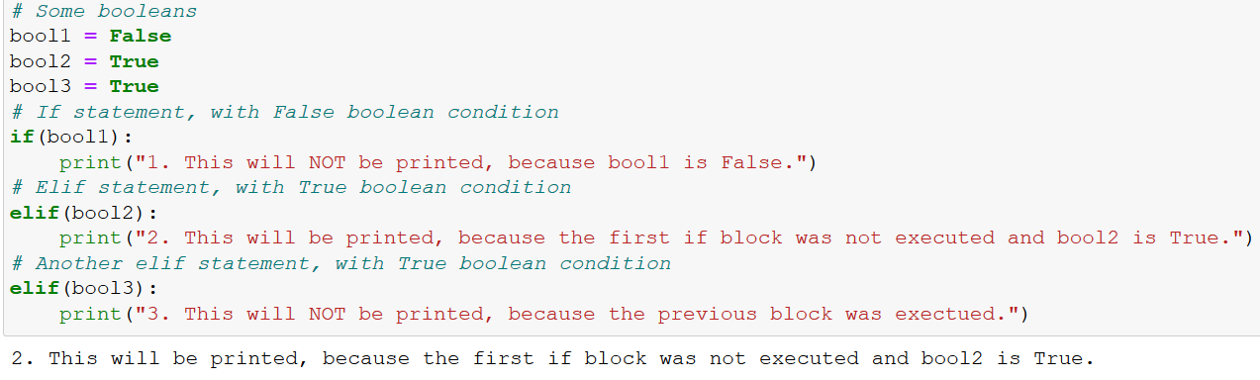
The elif statement (multiple blocks)
Multiple elif statements can be added after an initial if statement.
In this case, execute the code inside an elif, if and only if:
all the previous if/elif have failed,
and its Boolean condition is True.

Slide 25
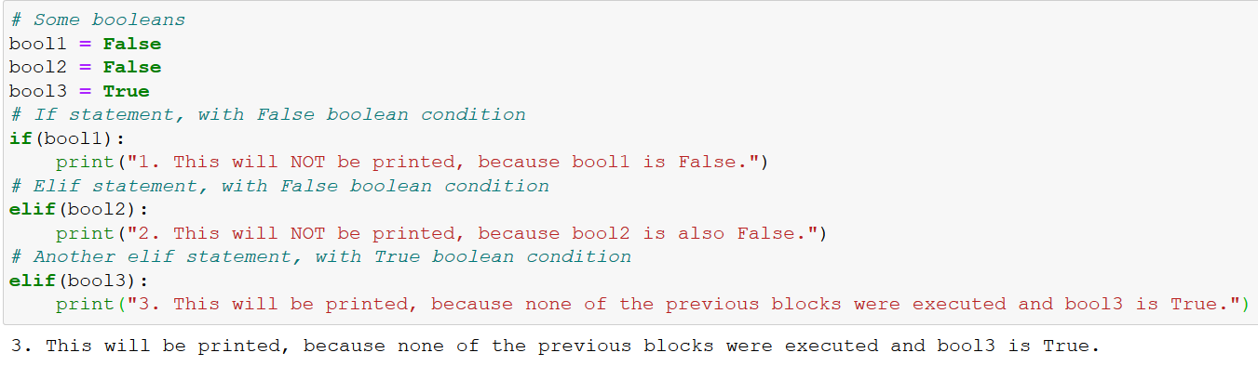
The elif statement (multiple blocks)
Multiple elif statements can be added after an initial if statement.
In this case, execute the code inside an elif, if and only if:
all the previous if/elif have failed,
and its Boolean condition is True.

Slide 26
An example of if/elif code
Example: write a code that receives a number x, and prints one of the following prompts, accordingly:
“x is strictly positive.”
“x is strictly negative.”
“x is zero.”
Let us use the if/elif structure to program that!

Slide 27
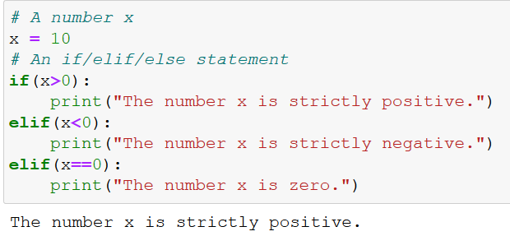
An example of if/elif code
Example: write a code that receives a number x, and prints one of the following prompts, accordingly:
“x is strictly positive.”
“x is strictly negative.”
“x is zero.”
Let us use the if/elif structure to program that!

Slide 28
Dead code
Definition (dead code): We call “dead code” a piece of code that was written, but is never going to be executed. Often, due to bad structure in code.

Slide 29
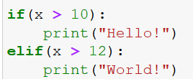
Dead code
Definition (dead code): We call “dead code” a piece of code that was written, but is never going to be executed. Often, due to bad structure in code.
Question: can you spot the line, which will never be executed, no matter what the value of x is?
Why is it dead code?

Slide 30
Dead code
Definition (dead code): We call “dead code” a piece of code that was written, but is never going to be executed. Often, due to bad structure in code.
Question: can you spot the line, which will never be executed, no matter what the value of x is?
Why is it dead code?
Dead code

Slide 31
Dead code
Definition (dead code): We call “dead code” a piece of code that was written, but is never going to be executed. Often, due to bad structure in code.
Question: can you spot the line, which will never be executed, no matter what the value of x is?
Why is it dead code?
Dead code
Reason: Variable x cannot be both lower than 10 and greater than 12.
We need the if block to fail, for the elif to be checked. It means x must be lower than 10. But then, passing the Boolean condition in the elif requires having x greater than 12, but x will already be lower than 10 at this point.

Slide 32
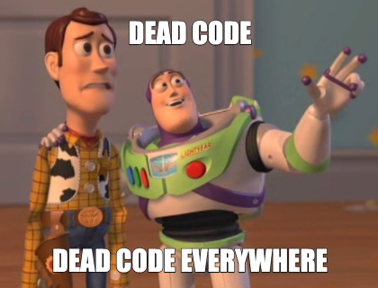
Dead code
Definition (dead code): We call “dead code” a piece of code that was written, but is never going to be executed. Often, due to bad structure in code.
Dead code is often due to bad structure/design in the code.
Be careful!

Slide 33
The else statement
The else statement is used to define a block of code to execute, if and only if ALL the previous if/elif statement have failed.

Slide 34
The else statement
The else statement is used to define a block of code to execute, if and only if ALL the previous if/elif statement have failed.
Same structure as an elif, but…
Comes last, after all the if/elif statements.
No Boolean condition to be checked.

Slide 35
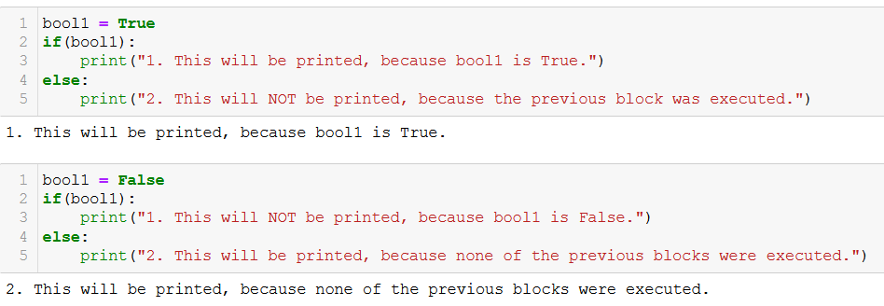
The else statement (no elif example)
The else statement is used to define a block of code to execute, if and only if ALL the previous if/elif statement have failed.
Same structure as an elif, but…
Comes last, after all the if/elif statements.
No Boolean condition to be checked.

Slide 36
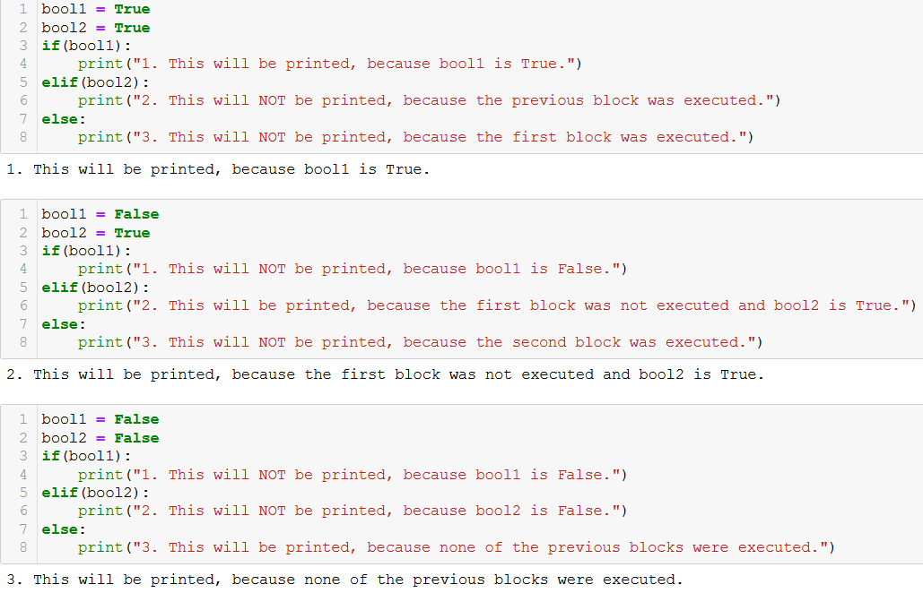
The else statement (multiple elif example)

Slide 37
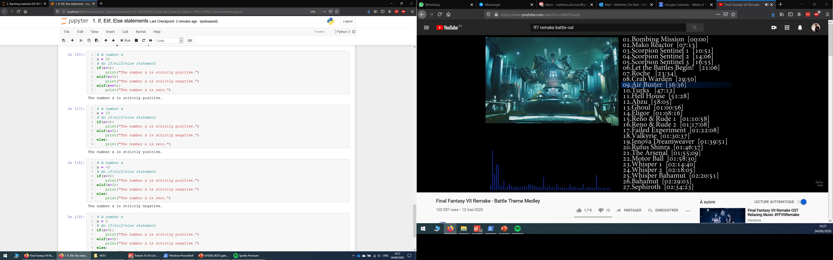
Our previous if/elif example, turned into an if/elif/else example

Slide 38
Our previous if/elif example, turned into an if/elif/else example

Slide 39
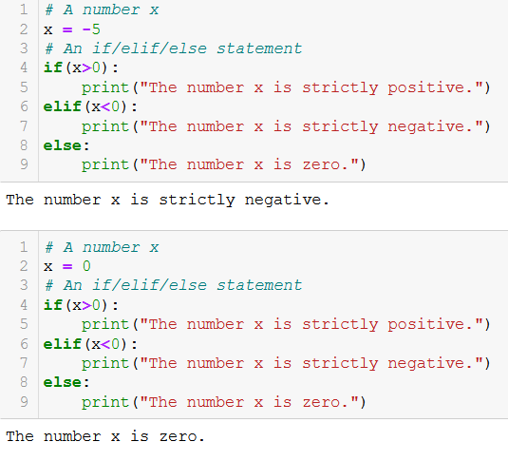
Our previous if/elif example, turned into an if/elif/else example

Slide 40
Practice activities for if/elif/else
Let us practice the if/elif/else concepts a bit, with two activities.
Activity 1 – Ask for user’s age.ipynb
Activity 2 - Strength to lifepoints.ipynb

Slide 41
Activity 1 – Ask for user’s age
Write a function ask_user_age(), as described below.
It receives no parameters and returns no parameters.
It first asks for the user to input its age, and retrieves the info from the user.
If the age is negative (0 included), the function should print a message that reads "Your age cannot be negative, it must be at least 1."
If the age given by the user is larger than 122 (oldest person on record, Jeanne Calment), then the print should display "I really doubt you are ___ years old..." with the blank filled accordingly.
Otherwise, the function should print "Oh, you are ___ years old? That's cool!", with the blank filled accordingly.

Slide 42
Activity 2 - Strength to lifepoints
Write a function strength_to_lifepoints(), according to the following requirements.
This function receives a single parameter, strength_points, which corresponds to the number of strength points our main character has, and - for simplicity - will only take integer values.
This function returns a single output, lifepoints, which corresponds to the number of lifepoints our main character will have, based on its strength points.
Our main character has a base number of 50 lifepoints (that means it has 50 lifepoints, by default, if its strength is zero).
For each strength point, our hero will gain 10 extra lifepoints.
If the main character has at least 50 strength points, it gains a one-time bonus of 100 lifepoints, on top of the lifepoints it already has.
Finally, if the main character has at least 100 strength points, it gains another one-time bonus of 50% extra lifepoints, on top of all the lifepoints it already has and the previous bonuses.

Slide 43
Nested if structures
Definition (nested if structure): A nested if structure is a structure which includes one or multiple if statement(s), inside another if statement.

Slide 44
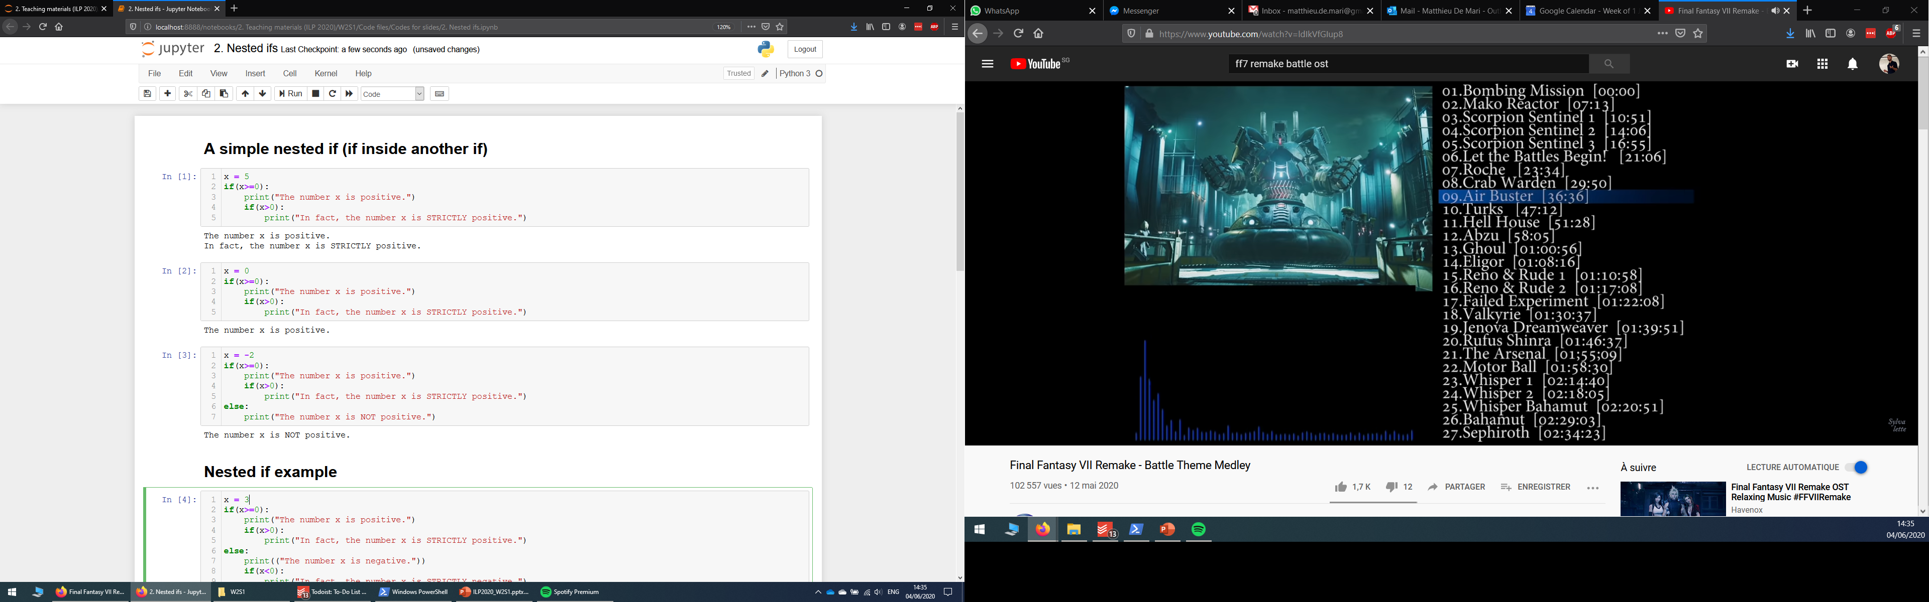
Nested if structures
Definition (nested if structure): A nested if structure is a structure which includes one or multiple if statement(s), inside another if statement.
These are typically used to check additional conditions, based on whether another condition has been satisfied or not.

Slide 45
Nested if structures
Definition (nested if structure): A nested if structure is a structure which includes one or multiple if statement(s), inside another if statement.
These are typically used to check additional conditions, based on whether another condition has been satisfied or not.
Each if might have its own elif/else statements, placed on the same indentation level.

Slide 46
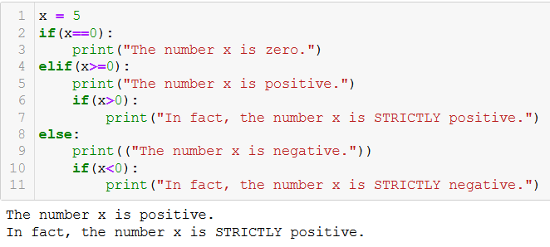
Nested if structures

Slide 47
Activity 3 - Race and class check
Write a function character_creation(), according to the following requirements.
The function will receive two parameters: user_race and user_class.
For simplicity, only three races are available: Human, Elf, and Dwarf.
For simplicity, only four classes are available: Warrior, Hunter, Mage and Priest.
Humans can play all classes.
Elves cannot be warriors.
Dwarves cannot be mages or priests.
The function should not return anything.
It should print "You cannot play a character that is ...{race} and ...{class}.", with blanks filled accordingly, if the combination of user_race and user_class is not acceptable.
Not acceptable here means that its race and/or class is not among the ones listed above, or the combination is not permitted, as listed above.
If the combination is valid, it should print "Your character's race is ...{race} and your character's class is ...{class}.", with blanks filled accordingly.

Slide 48
Conclusion
The if statement
The elif statement
The else statement
Dead code and code structure
Nested ifs

Slide 49
Up for a challenge? (in the Extra challenges folder)
Activity 2+ - Strength to lifepoints (extra challenge).ipynb
Redo the activity 2, but this time…
Do not use any conditional statement (if/while)
The function should only contain one line, which starts with return.

Slide 50
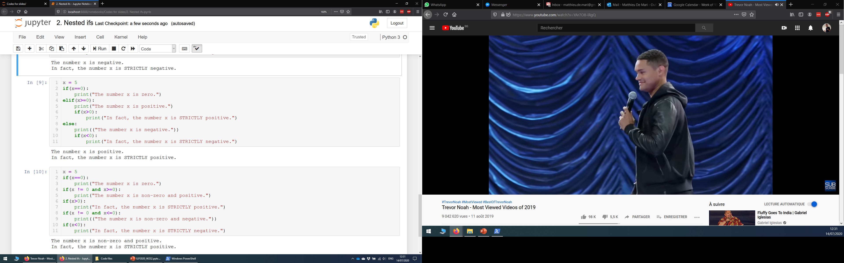
Nested if structures vs. combined conditionals
Nested if structures can, most of the time, be rewritten with combined conditionals (using and/or Boolean operators).

Slide 51
Nested if structures vs. combined conditionals
Nested if structures can, most of the time, be rewritten with combined conditionals (using and/or Boolean operators).
For instance, both structures on the right are equivalent.

Slide 52
Nested if structures vs. combined conditionals
Nested if structures can, most of the time, be rewritten with combined conditionals (using and/or Boolean operators).
For instance, both structures on the right are equivalent.
Personal preference: Whenever possible, try to avoid the nested if structures. They are often overly complicated and prone to errors in designing the code.

